Slide 1

Islamic University of Technology
Course no: Phy 4143
Course Title: Physics II
Course Teacher : Dr Md. Sahab Uddin
Professor

Slide 2
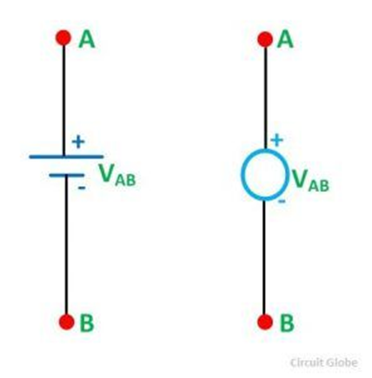
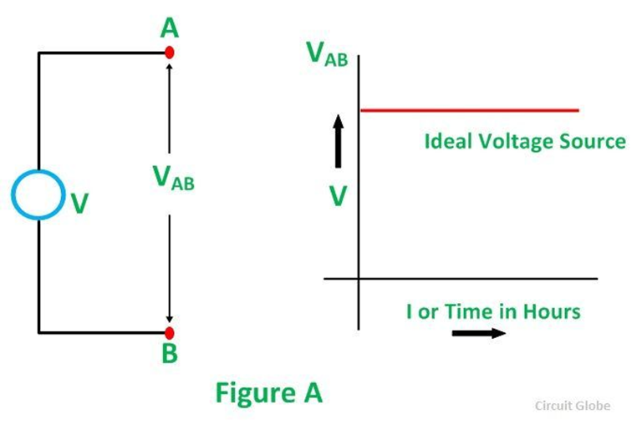
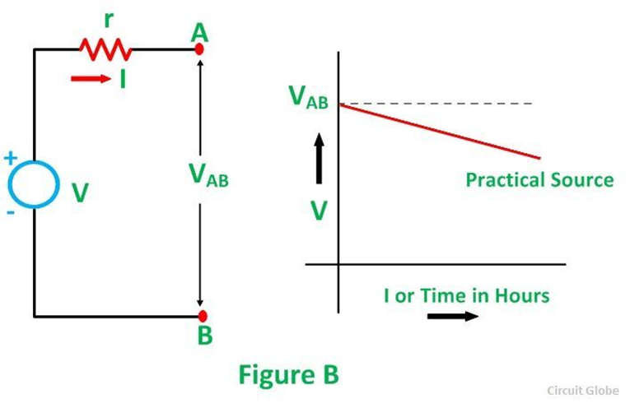
Voltage source, current source and transformation
Voltage Source
Current Source
A Source is a device which converts mechanical, chemical, thermal or some other form of energy into electrical energy. In other words, the source is an active network element meant for generating electrical energy.
Voltage source: A voltage source is a two-terminal device whose voltage at any instant of time is constant and is independent of the current drawn from it. Such a voltage source is called an Ideal Voltage Source and have zero internal resistance.
The example of voltage sources is batteries and alternators.

Slide 3
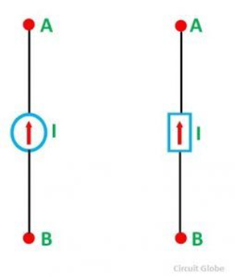
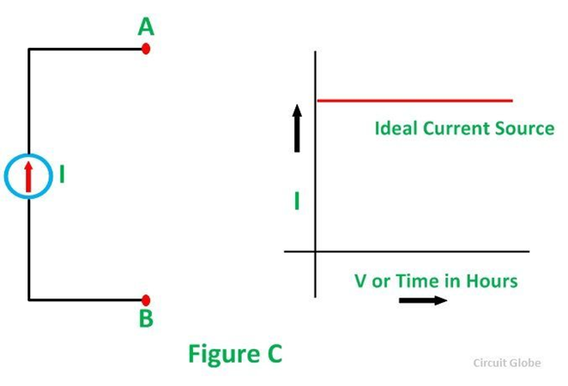
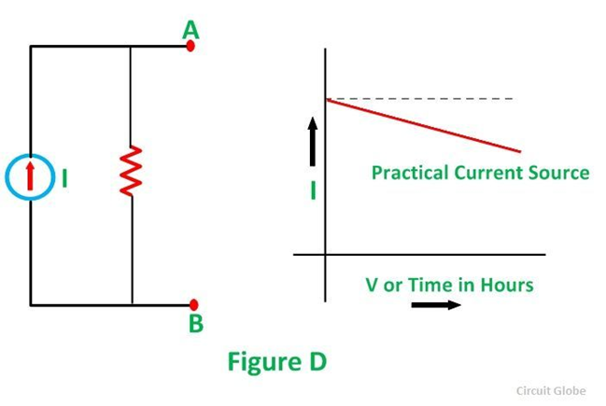
An ideal current source is a two-terminal circuit element which supplies the same current to any load resistance connected across its terminals. It is important to keep in mind that the current supplied by the current source is independent of the voltage of source terminals. It has infinite resistance.
The example of current sources is photoelectric cells, collector currents of transistors.

Slide 4
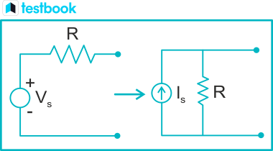
Voltage Source to Current Source Conversion
For any practical voltage source, if the ideal voltage is V and the internal resistance is R, the voltage source can be replaced by an equivalent current source I with the internal resistance R in parallel with the current source.
Fig-Voltage Source to Current Source Conversion
Here, Is=VR

Slide 5
Steps for Source Transformation
1. Identify the part of the circuit suitable for transformation.
2. Apply the transformation using the above equations.
3. Simplify the resulting circuit to analyze it easily.
Advantages of Source Transformation
The source transformation technique offers several benefits, particularly when dealing with complex circuits:
Simplifies Circuit Analysis: By reducing the number of components in a circuit, source transformation makes the overall analysis faster and more manageable, especially for circuits with multiple sources and resistors.
2. Reduces Complexity: It helps in reducing a multi-source circuit into simpler single-source circuits, often making it easier to apply methods like Ohm’s law, Kirchhoff’s Current Law (KCL), and Kirchhoff’s Voltage Law (KVL).
3. Efficient Use in Theoretical and Practical Circuits: Whether you're dealing with theoretical problems or real-world applications, the ability to transform sources helps in both DC and AC circuit analysis.
4. Improves Accuracy in Competitive Exams: In exams, quickly reducing circuits using source transformation techniques ensures faster and more accurate results, particularly in subjects like network theory.
5. Flexibility in Complex Circuit Designs: Engineers use source transformation when working with large-scale circuits to reduce their complexity without altering the performance or behaviour of the system.

Slide 6
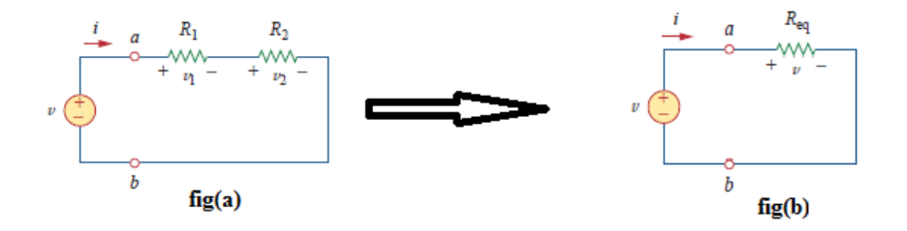
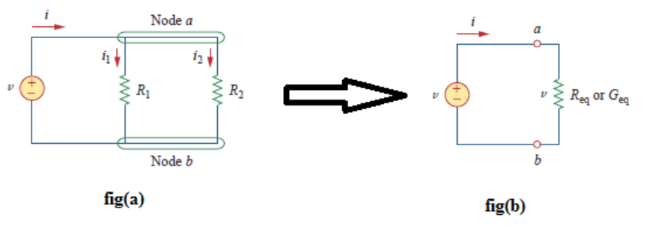

Series Connection of Resistors: Two or more resistors in a circuit are said to be in series when the current flowing through all the resistors is the same.
R_{eq} =R₁ + R₂
Parallel Connection of Resistors: Two or more resistors in a circuit are said to be in Parallel when all the resistors are connected to the same nodes and the same voltage is appearing across all these elements.

Slide 7
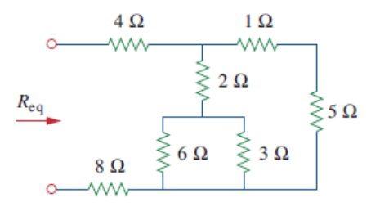
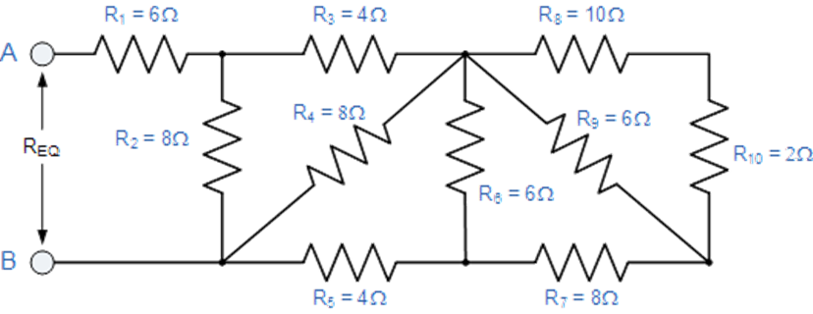
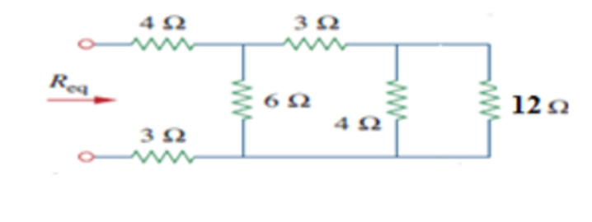
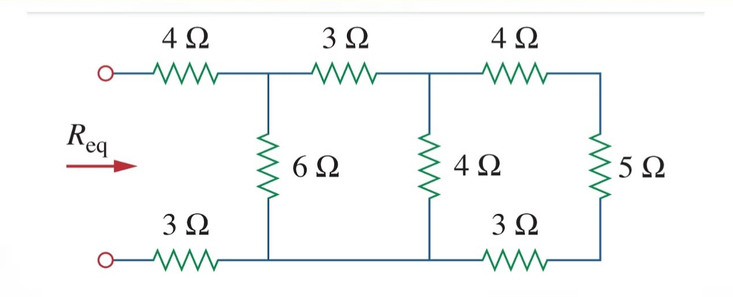
1) Find the Req for the circuit shown in below figure.
2) Find the Req for the circuit shown in below figure.
3) Find the Req for the circuit shown in below figure.
4) Find the Req for the circuit shown in below figure.

Slide 8
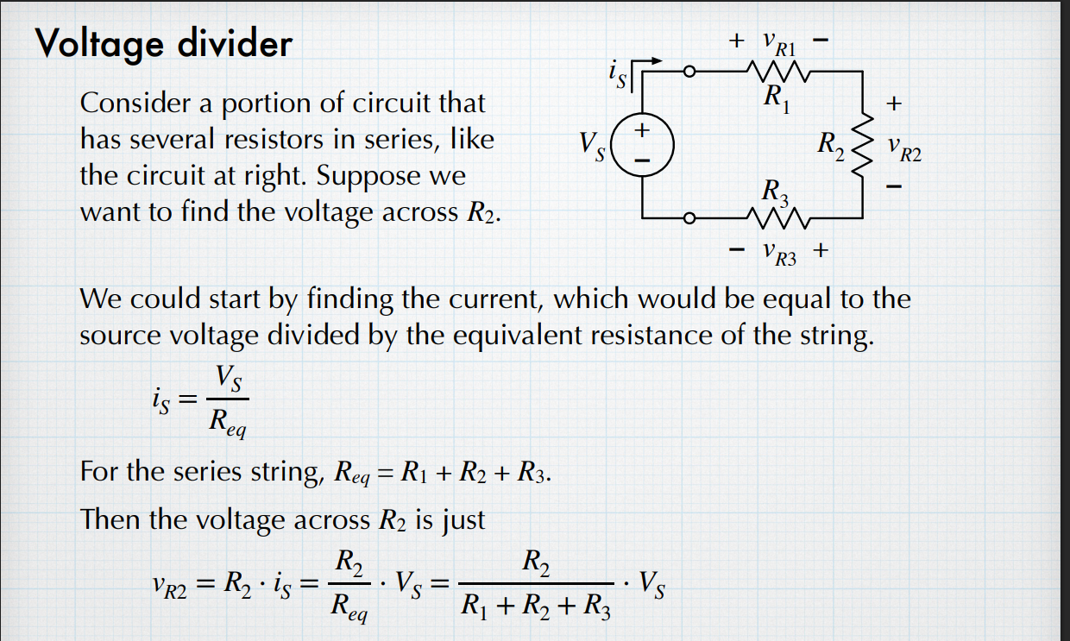
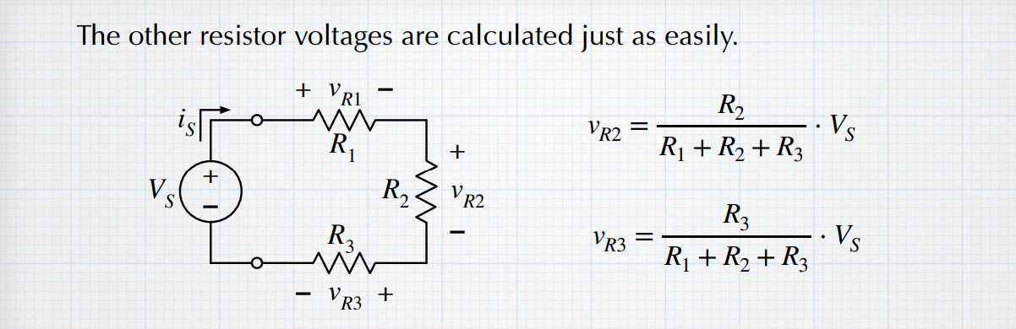
Voltage Divider Rule

Slide 9
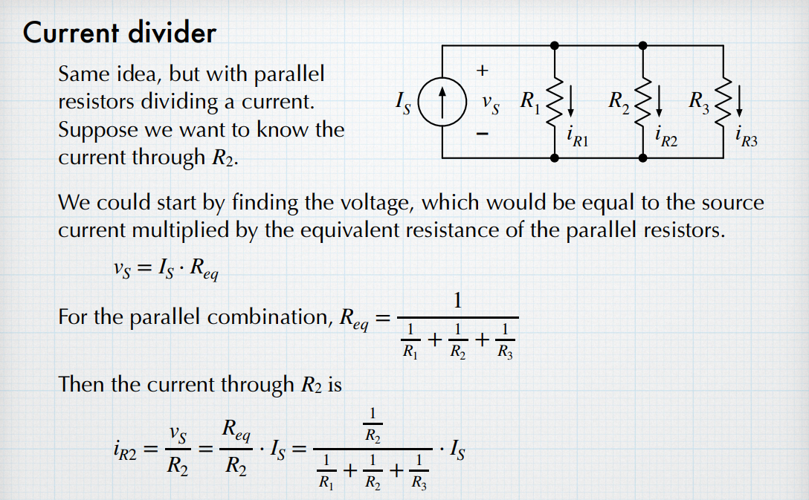
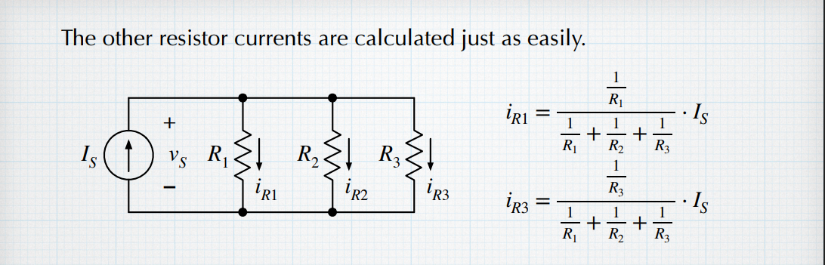
Current Divider Rule

Slide 10
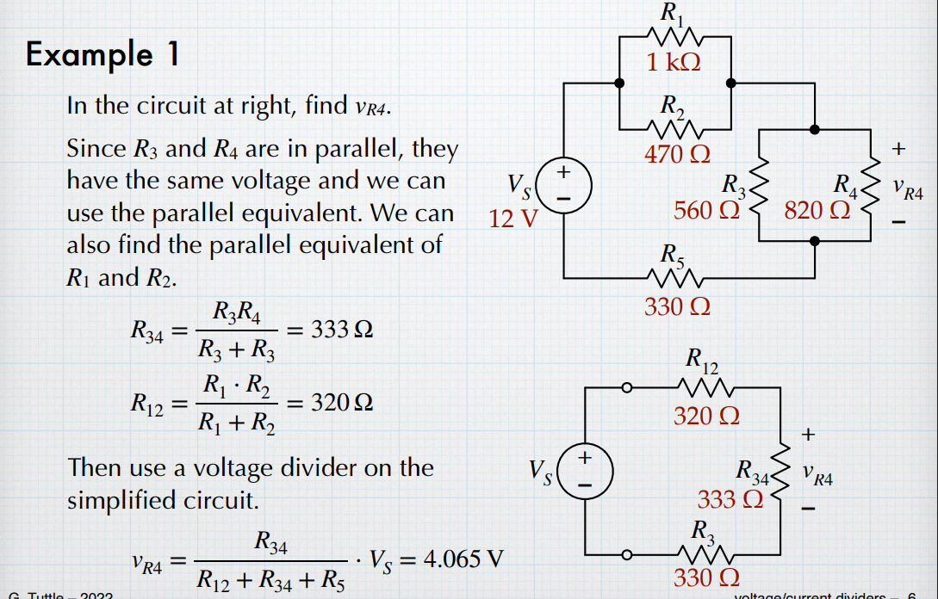

Slide 11
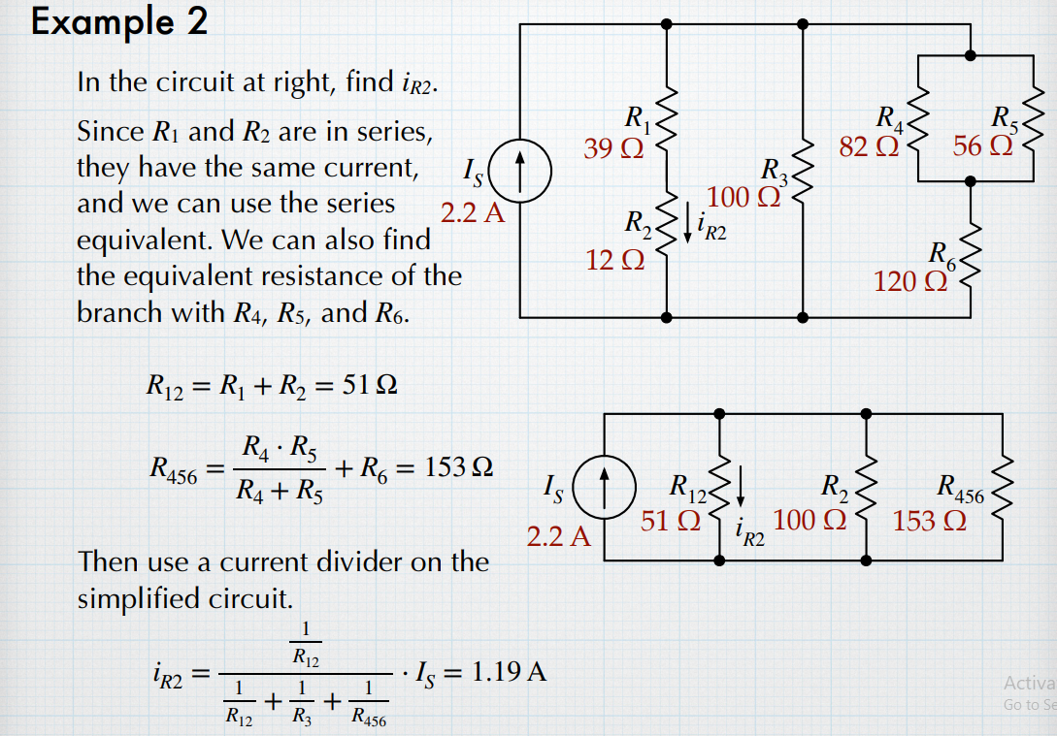

Slide 12
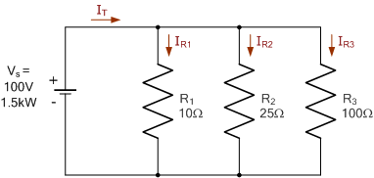
Problem : Three resistors are connected together to form a current divider circuit as shown below. If the circuit is fed from a 100 volts supply with a capacity of 1.5kW. Calculate the individual branch currents using the current division rule and find the equivalent circuit resistance.

